Slide 1




Turkish Academic Network and Information Center
&
Onur Temizsoylu
Senior Chief Researcher
07/10/2022

Slide 2
OUTLINE
01
02
03
About ULAKBİM
Turkish Science e-Infrastructure
EuroHPC Activities

Slide 3

TÜBİTAK ULAKBİM
TÜBİTAK ULAKBİM
TÜBİTAK (The Scientific and Technological Research Council of Turkey) is the leading agency for management, funding and conduct research through the national targets and priorities.
>6000 researchers in 20 different research institutes.
ULAKBİM is an institute of TÜBİTAK that is tasked with providing e-Research Infrastructures to researchers and universities.
Network Technologies
    ULAKNET
    TRUBA
    AcademicCloud (OpenStack)
Cahit Arf Information Center
  EKUAL
  UBYT
  JournalPark
  Document Supply
  TR Index
  Bibliometric Analysis
Education Technologies
  PARDUS
Notes:
3

Slide 4
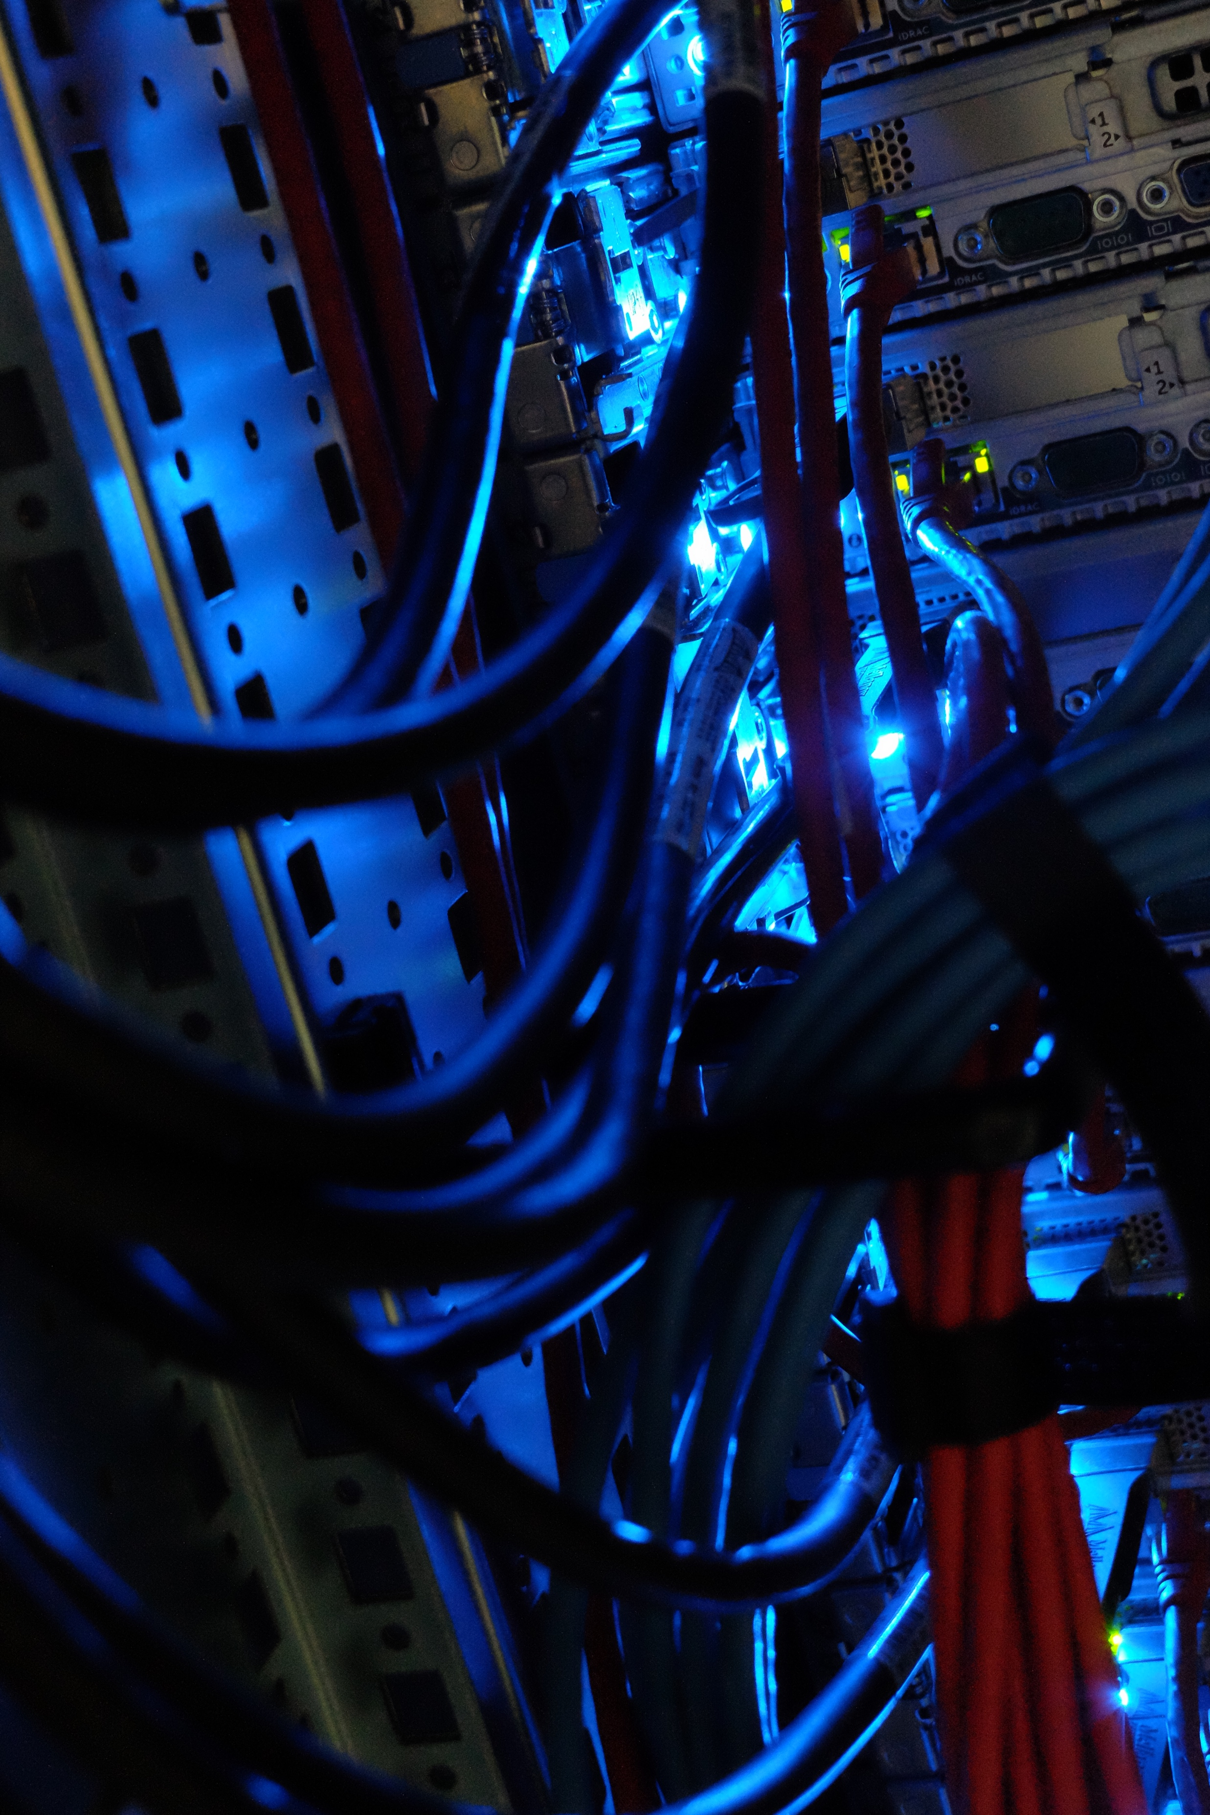
TRUBA - History
  2003
    Beowulf cluster composed of 128 PCs
  2006-2008
    TUGA – Turkish National Grid Infrastructure (7 sites)
    Funded by TÜBİTAK
    HTC
  2009-2011
    TR-Grid Research e-Infrastructure
    Funded by State Planning Organization
    HTC, HPC, distributed storage
  2012-2019
    Turkish Science e-Infrastructure (TRUBA) Strengthening
    Funded by Ministry of Development
    HPC, distributed storage
  2019-2023
    TRUBA 2023
    Funded by Presidency of Strategy and Budget
    TRUBA e-Research Center

Slide 5
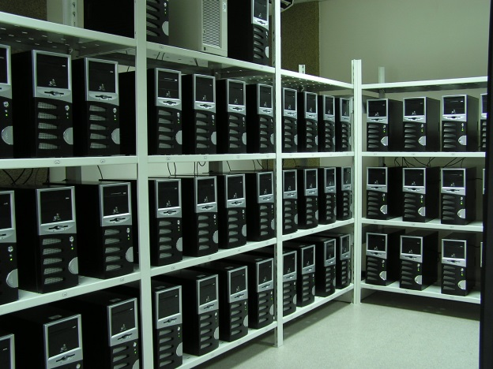
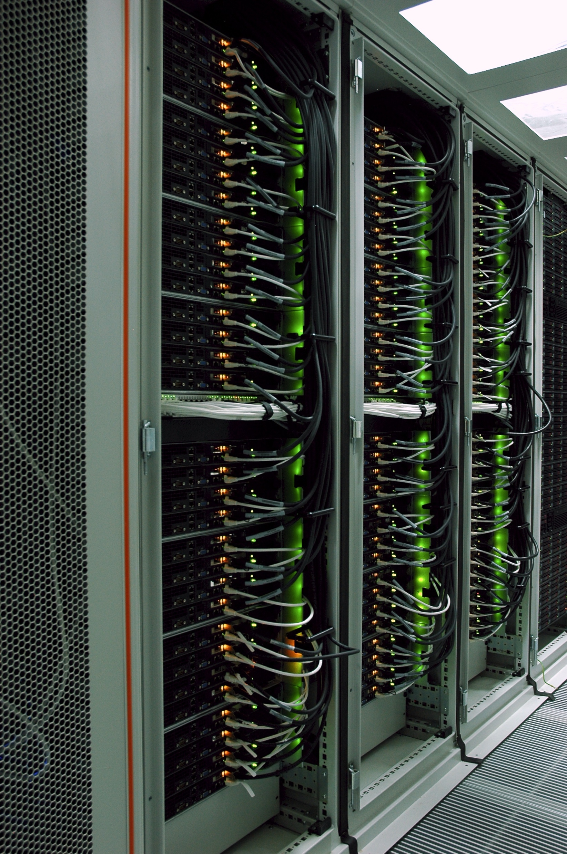
TRUBA
TR-Grid (2003-2010)
TRUBA (2010-...)

Slide 6
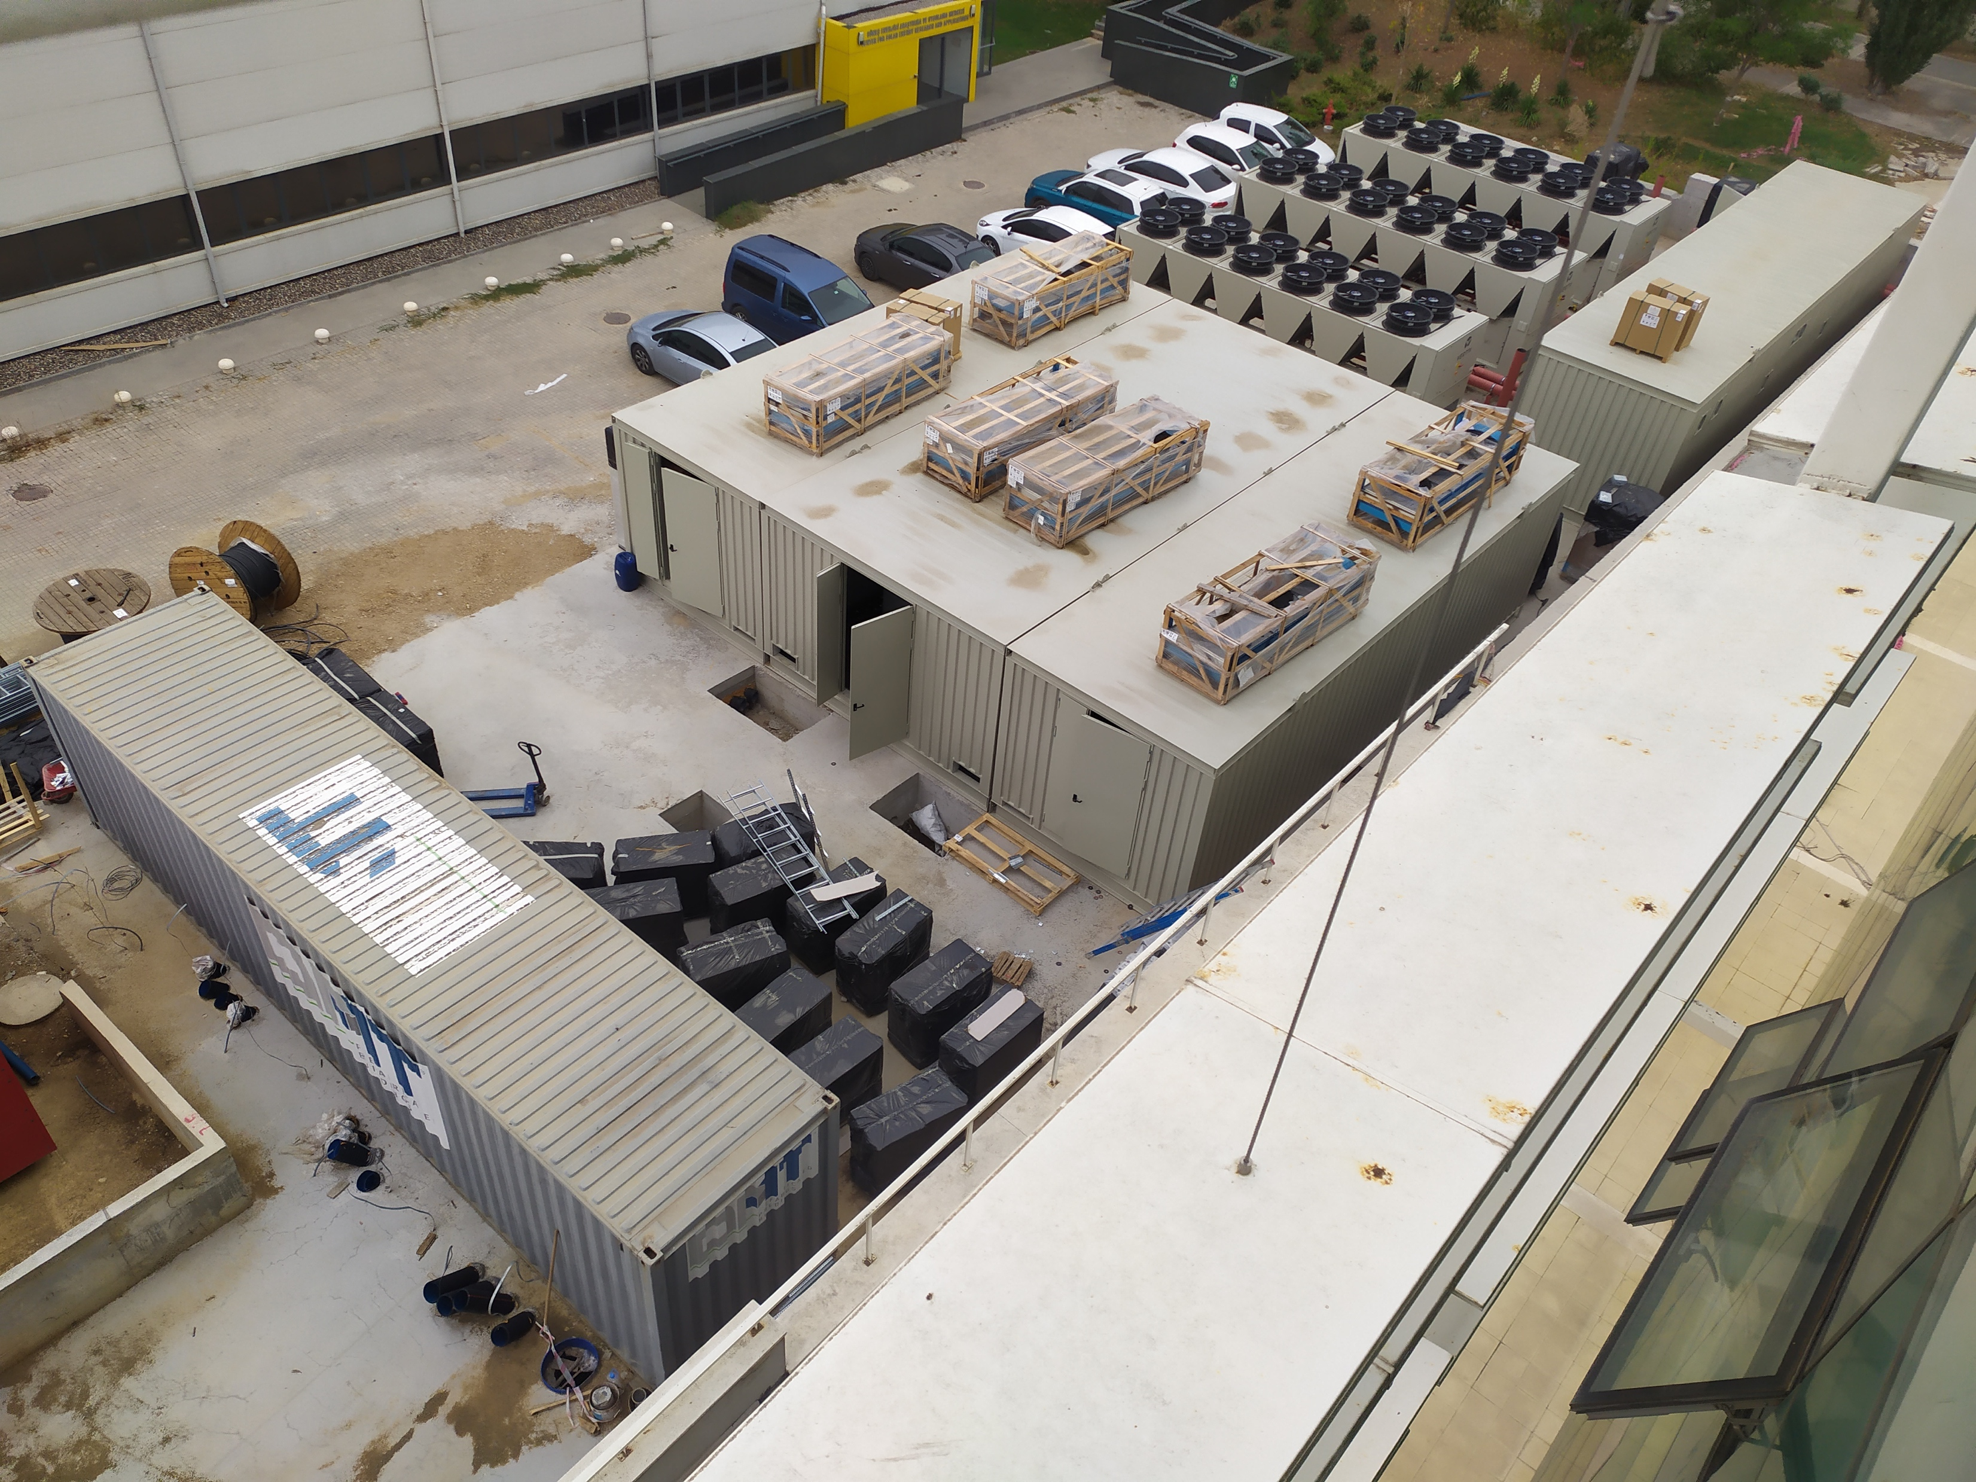
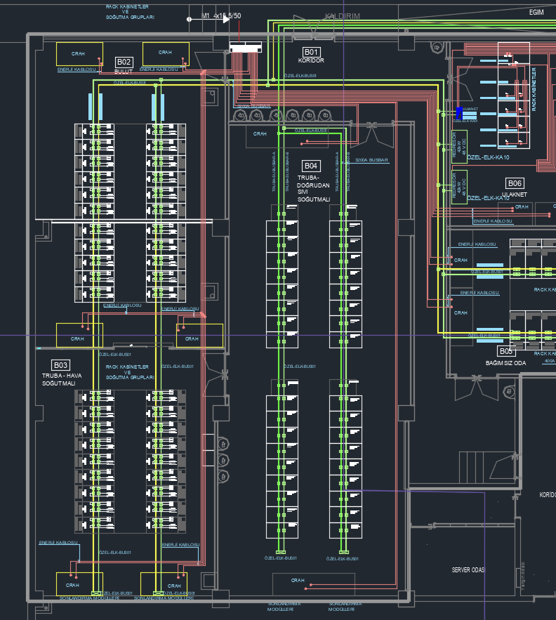
TRUBA

Slide 7
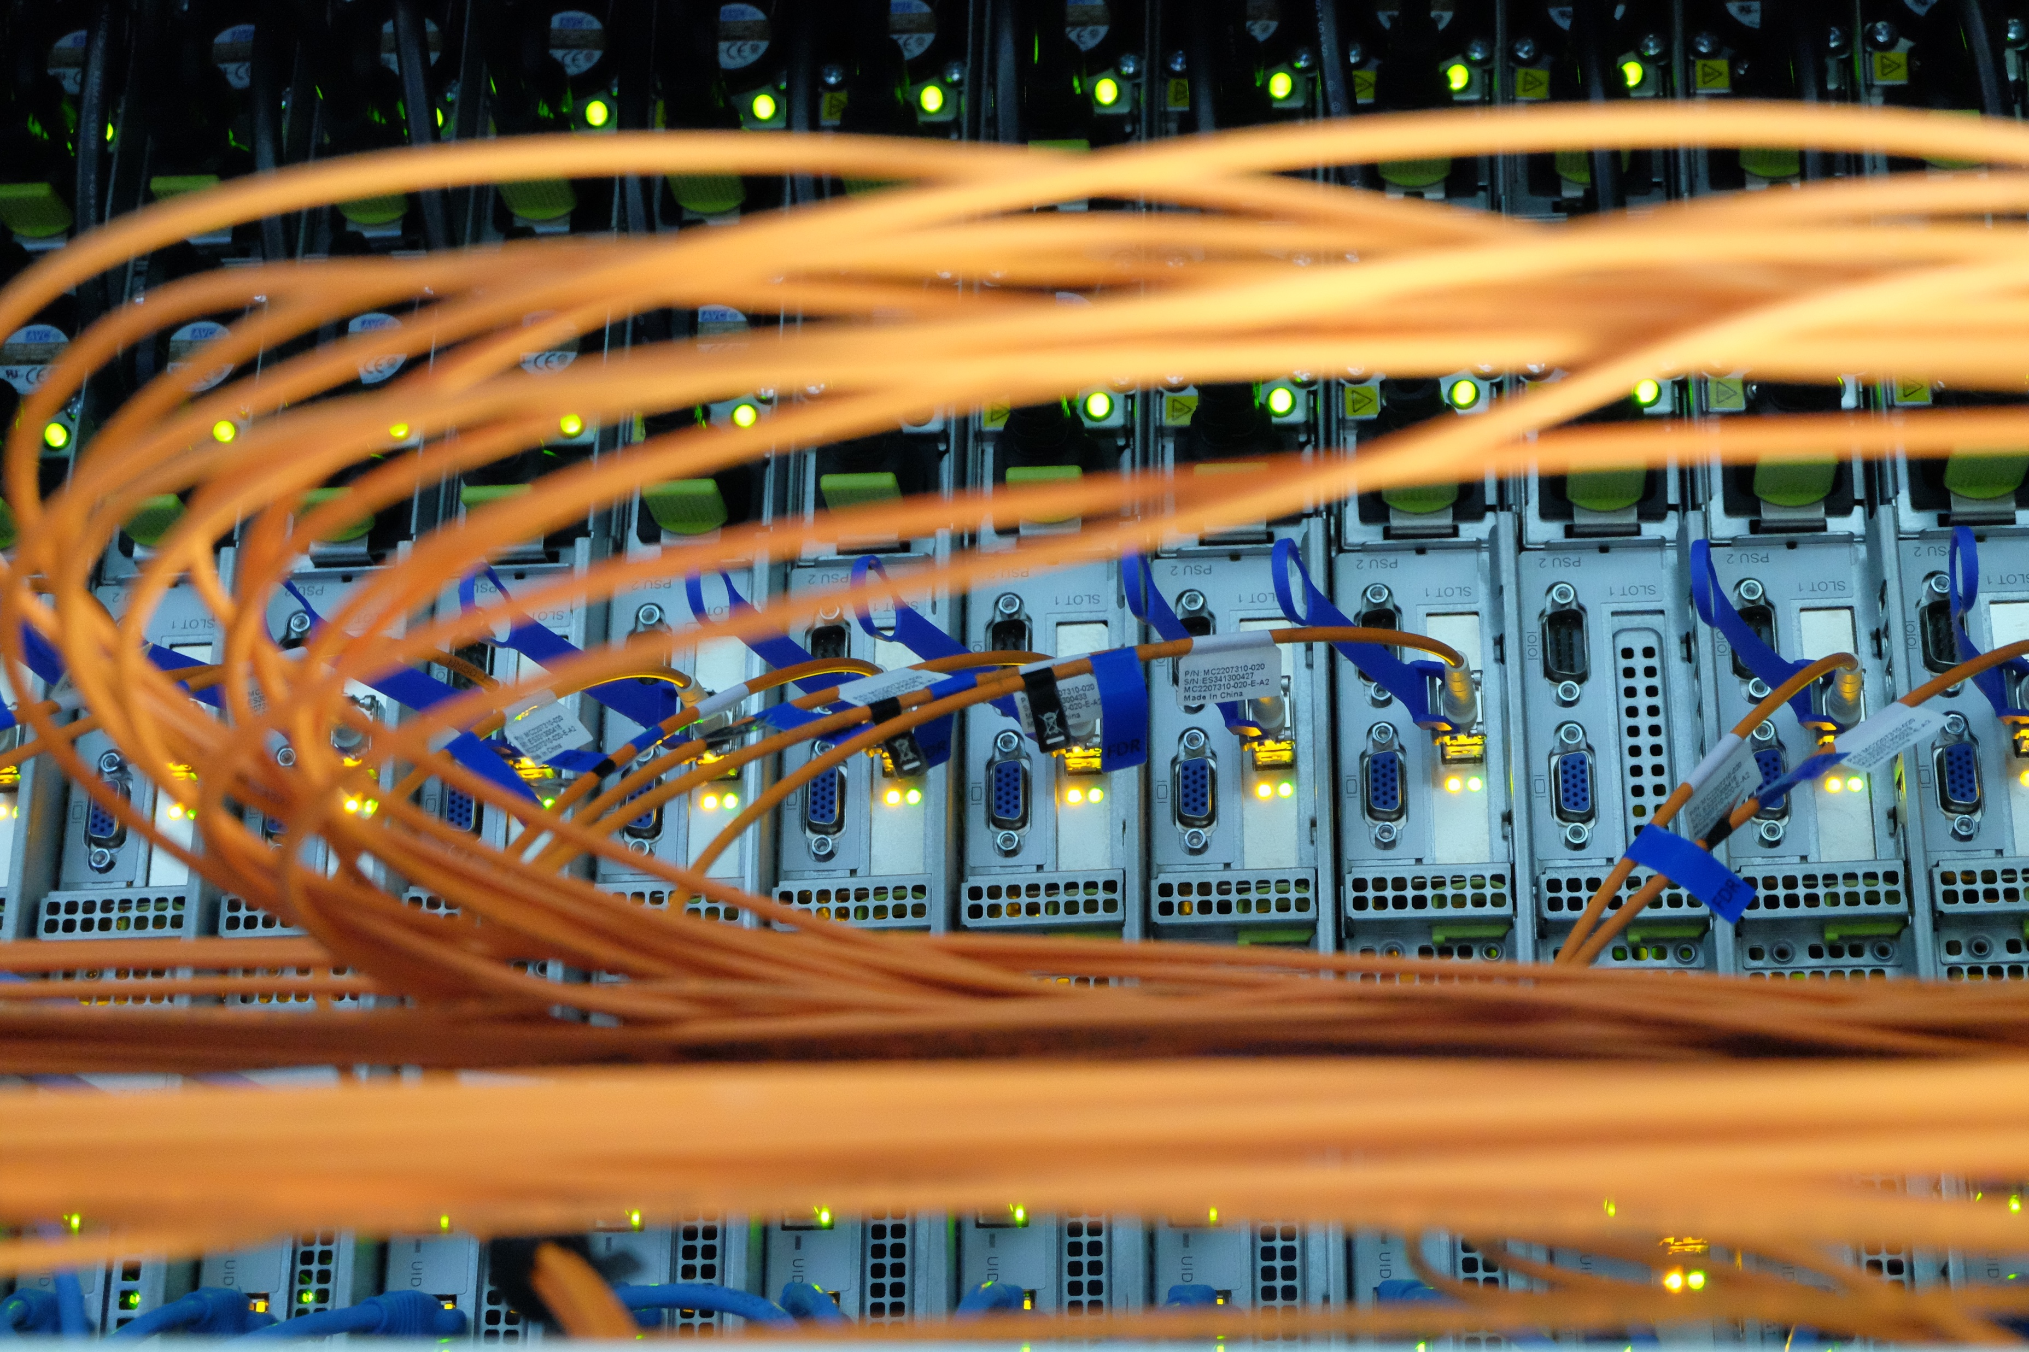
TRUBA – Current Status
  Resources
    25.000 CPU cores
    216 GPUs
    14 PB Lustre storage
  Kullanım
    15M core hours/month
    4600 registered users
    More than 400 distinct users per week
    159 ARDEB or University BAP Projects
    Projects with several public and industrial institutions

Slide 8

TRUBA – Who can use?
All academicians in Turkey including PhD students without any additional condition
BSc and MSc students with approval from their advisors
Researchers from ARDEB and BAP projects
TÜBİTAK and other public institutes
Industry

Slide 9
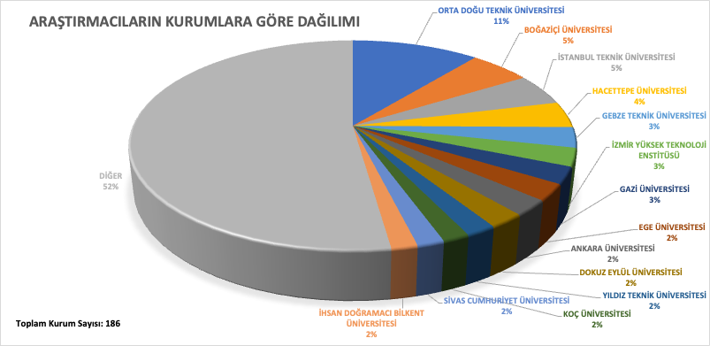
TRUBA – Users

Slide 10
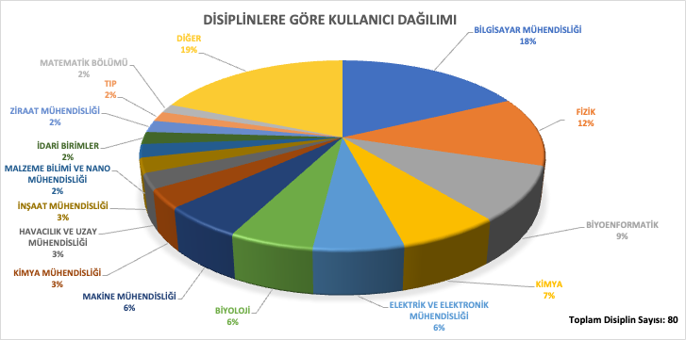
TRUBA – Users

Slide 11
TRUBA – Users

Slide 12
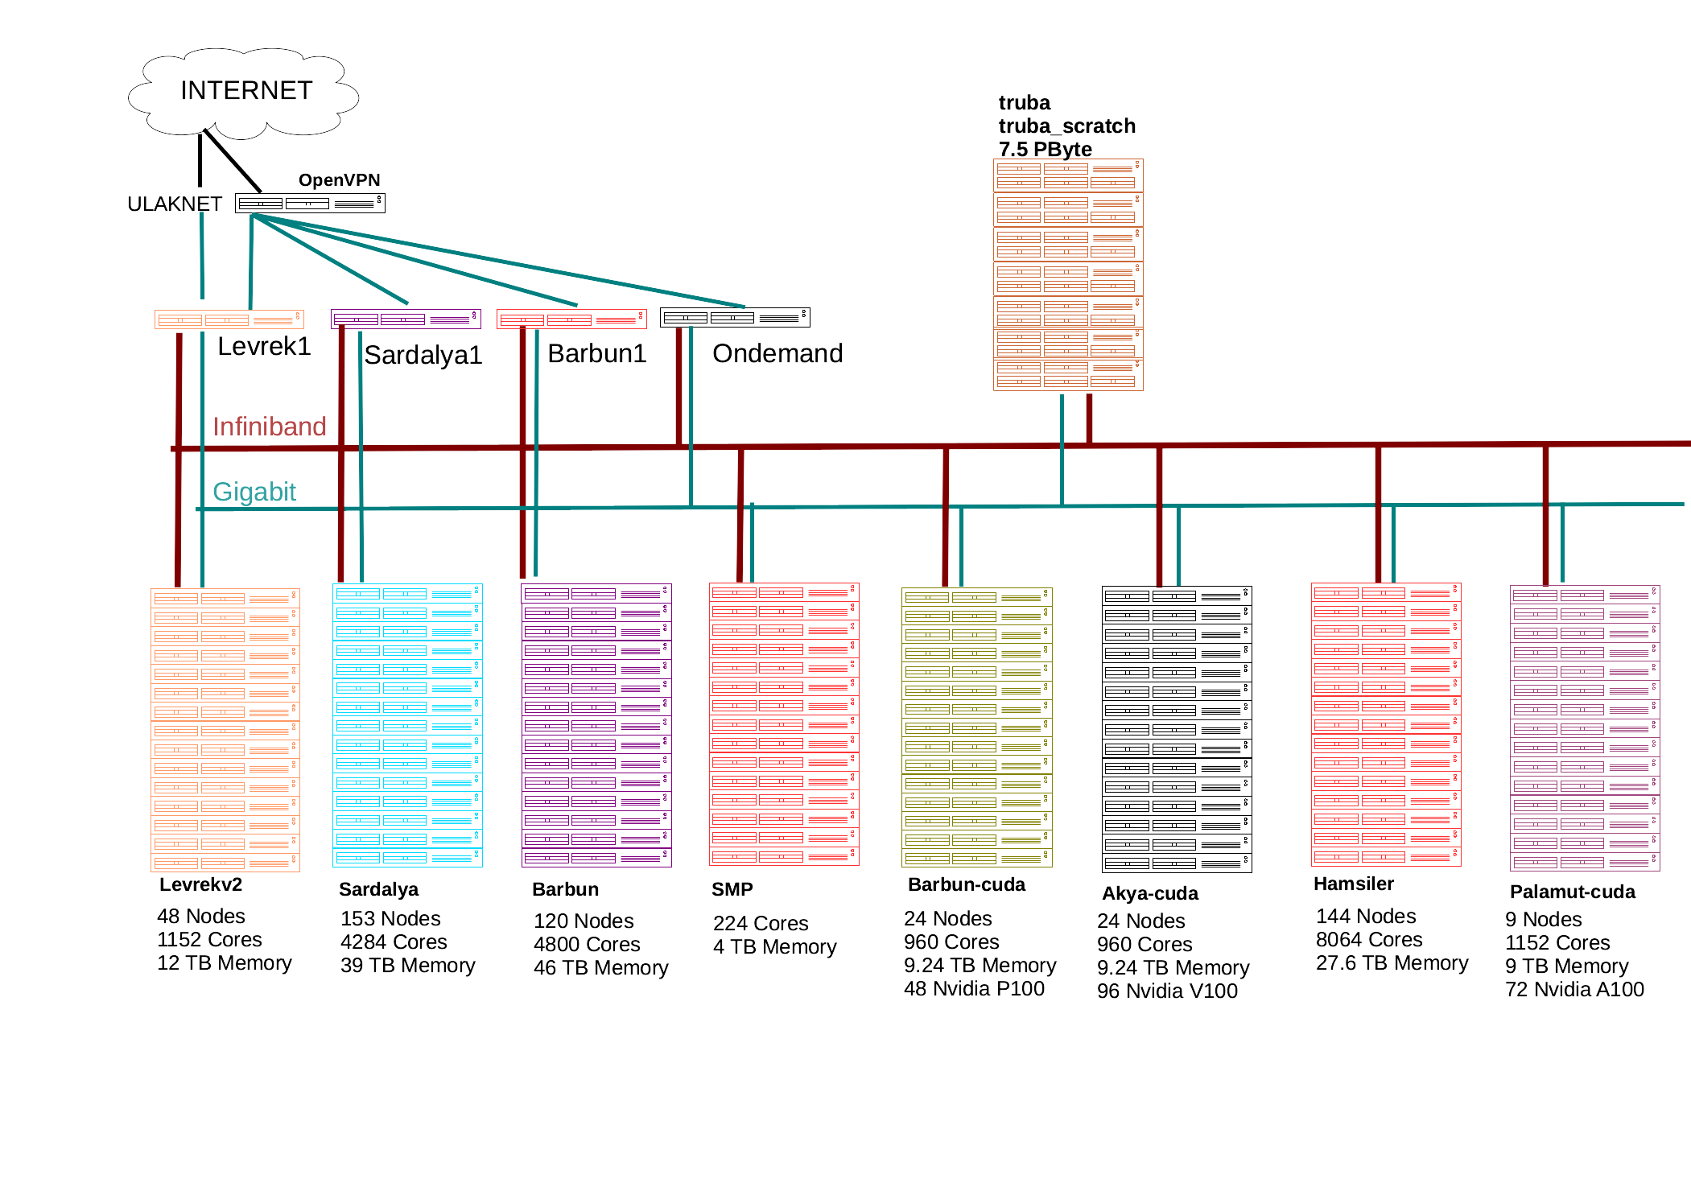
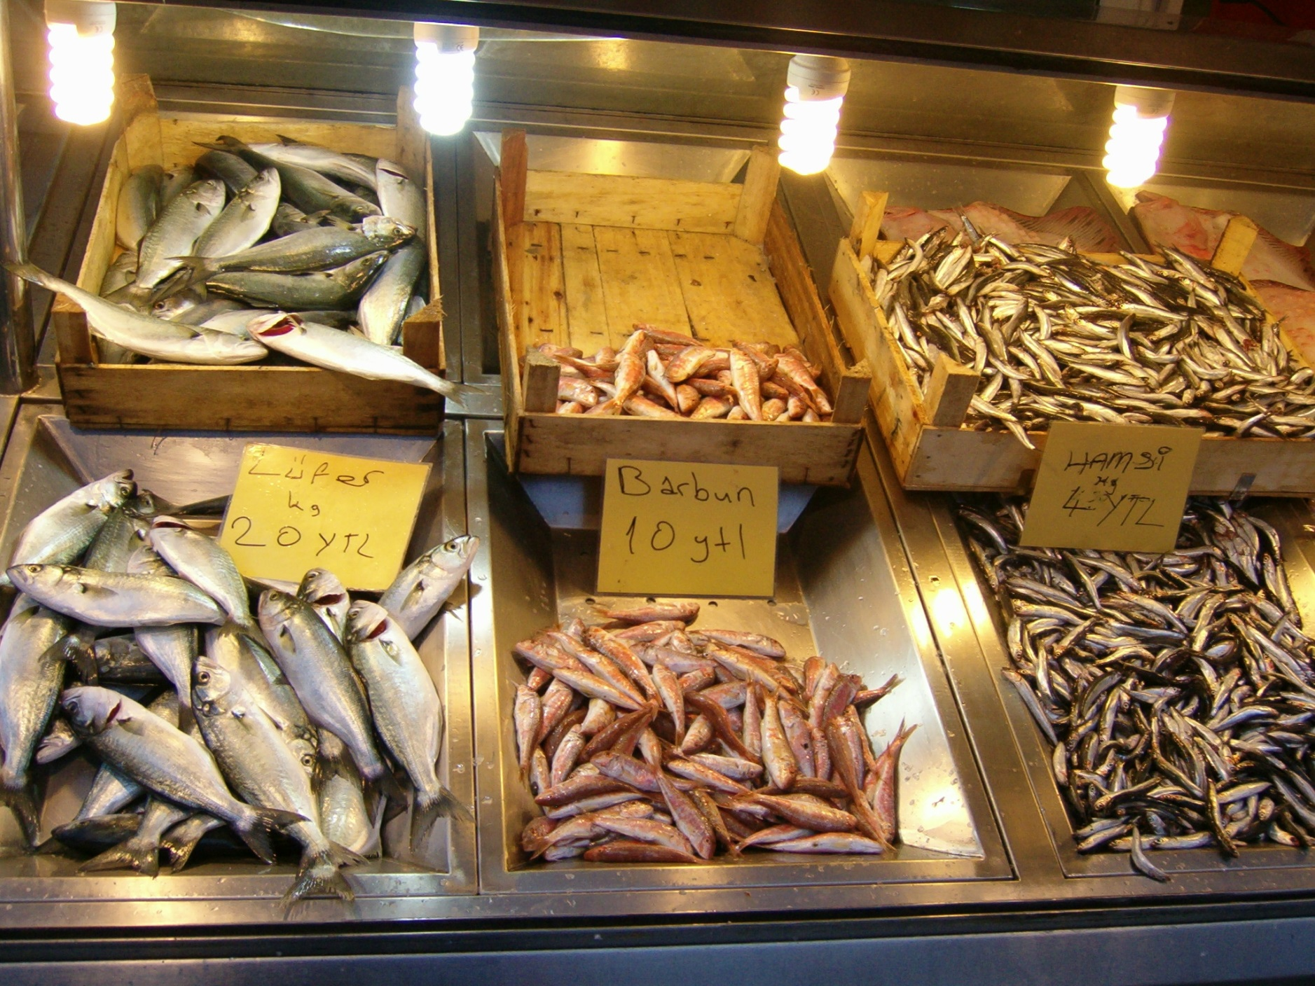
TRUBA – Clusters

Slide 13
TRUBA – General Purpose
Name of the Partition | Year Installed | #Node | Architecture | CPU | Performance (theoretical) | Memory
Levrek | 2013 | 128 | 8 çekirdek x 2 CPU | Xeon E5-2690 2.90GHz | 371.2 | 256 GB
Levrekv2 | 2014 | 48 | 12 çekirdek x 2 CPU | Xeon E5-2680 v3 2.50GHz | 960 | 256 GB
Orkinos | 2016 | 1 | 14 çekirdek x 16 CPU | Xeon E7-4850 v3 2.20GHz | 7.9Tflops | 4TB
Sardalya | 2017 | 128 | 14 çekirdek x 2 CPU | Xeon E5-2690 v3 2.60GHz | 1164Gflops | 256 GB
Barbun | 2018 | 120 | 20 çekirdek x 2 CPU | Xeon Scalable 6148 2.40GHz | 2048Gflops | 384 GB
Hamsi | 2021 | 144 | 28 çekirdek x 2 CPU | Xeon Gold 6258R 2.70GHz | 4800Gflops | 192GB

Slide 14
TRUBA – Accelerated
Name of the Partition | Year | #Node | Architecture | CPU | Performance | Memory | #GPU
Barbun-cuda | 2018 | 24 | 20 çekirdek x 2 CPU +2 x Nvidia P100 GPU | Xeon Scalable 6148 2.40GHz | 2048Gflops +9400Gflops | 384 GB + 2x16 GB HBM2 | 2
Akya-cuda | 2018 | 24 | 20 çekirdek x 2 CPU +4 x Nvidia V100 GPU | Xeon Scalable 6148 2.40GHz | 2048Gflops + 4x7800Gflops | 384 GB + 4x16 GB HBM2 | 4
Palamut-cuda | 2021 | 9 | 64 çekirdek x 2 CPU + 8 x Nvidia A100 GPU | AMD EPYC 7742 2.24 GHz | 4600 Gflops + 8x9600Gflops | 192GB + 8x80GB HBM2e | 8

Slide 15
TRUBA – Storage
Storage | Size | Purpose | Type
/truba | 7.5 Pbyte | Home and Application | Lustre
/truba_scratch |  | Runtime | Lustre
/tmp | 450GB-1.5Tbyte | Runtime | Local

Slide 16
TRUBA – Users

Slide 17
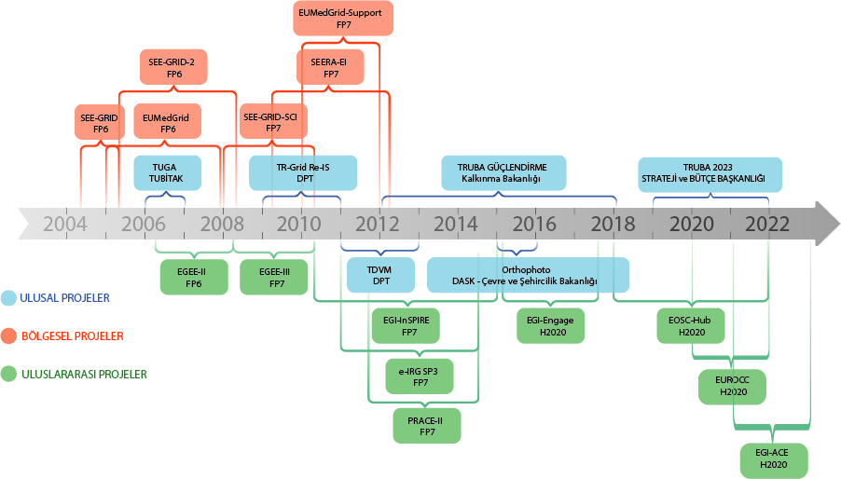

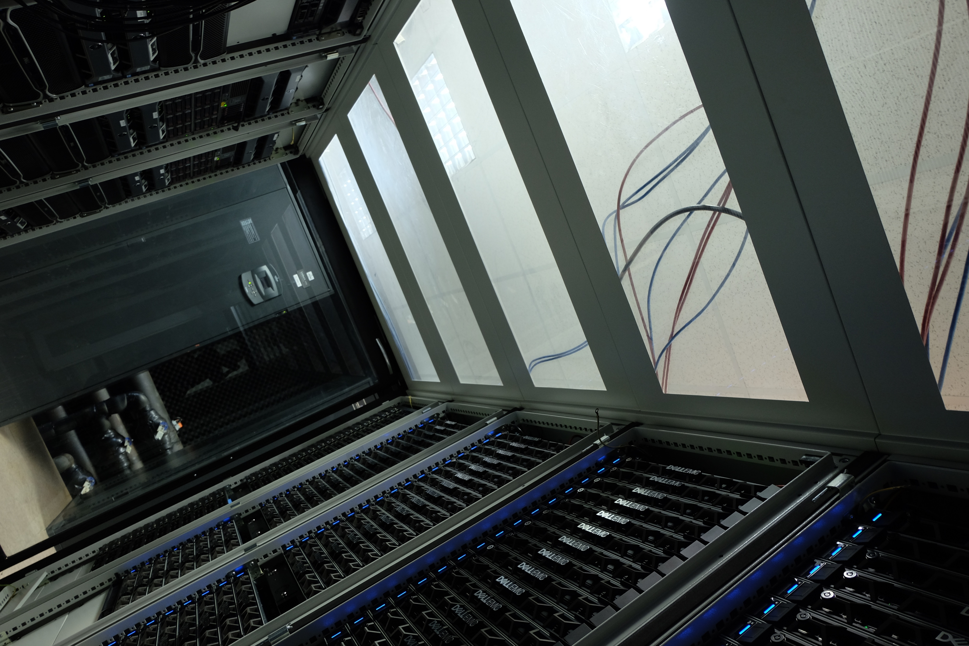

TRUBA –Projects

Slide 18
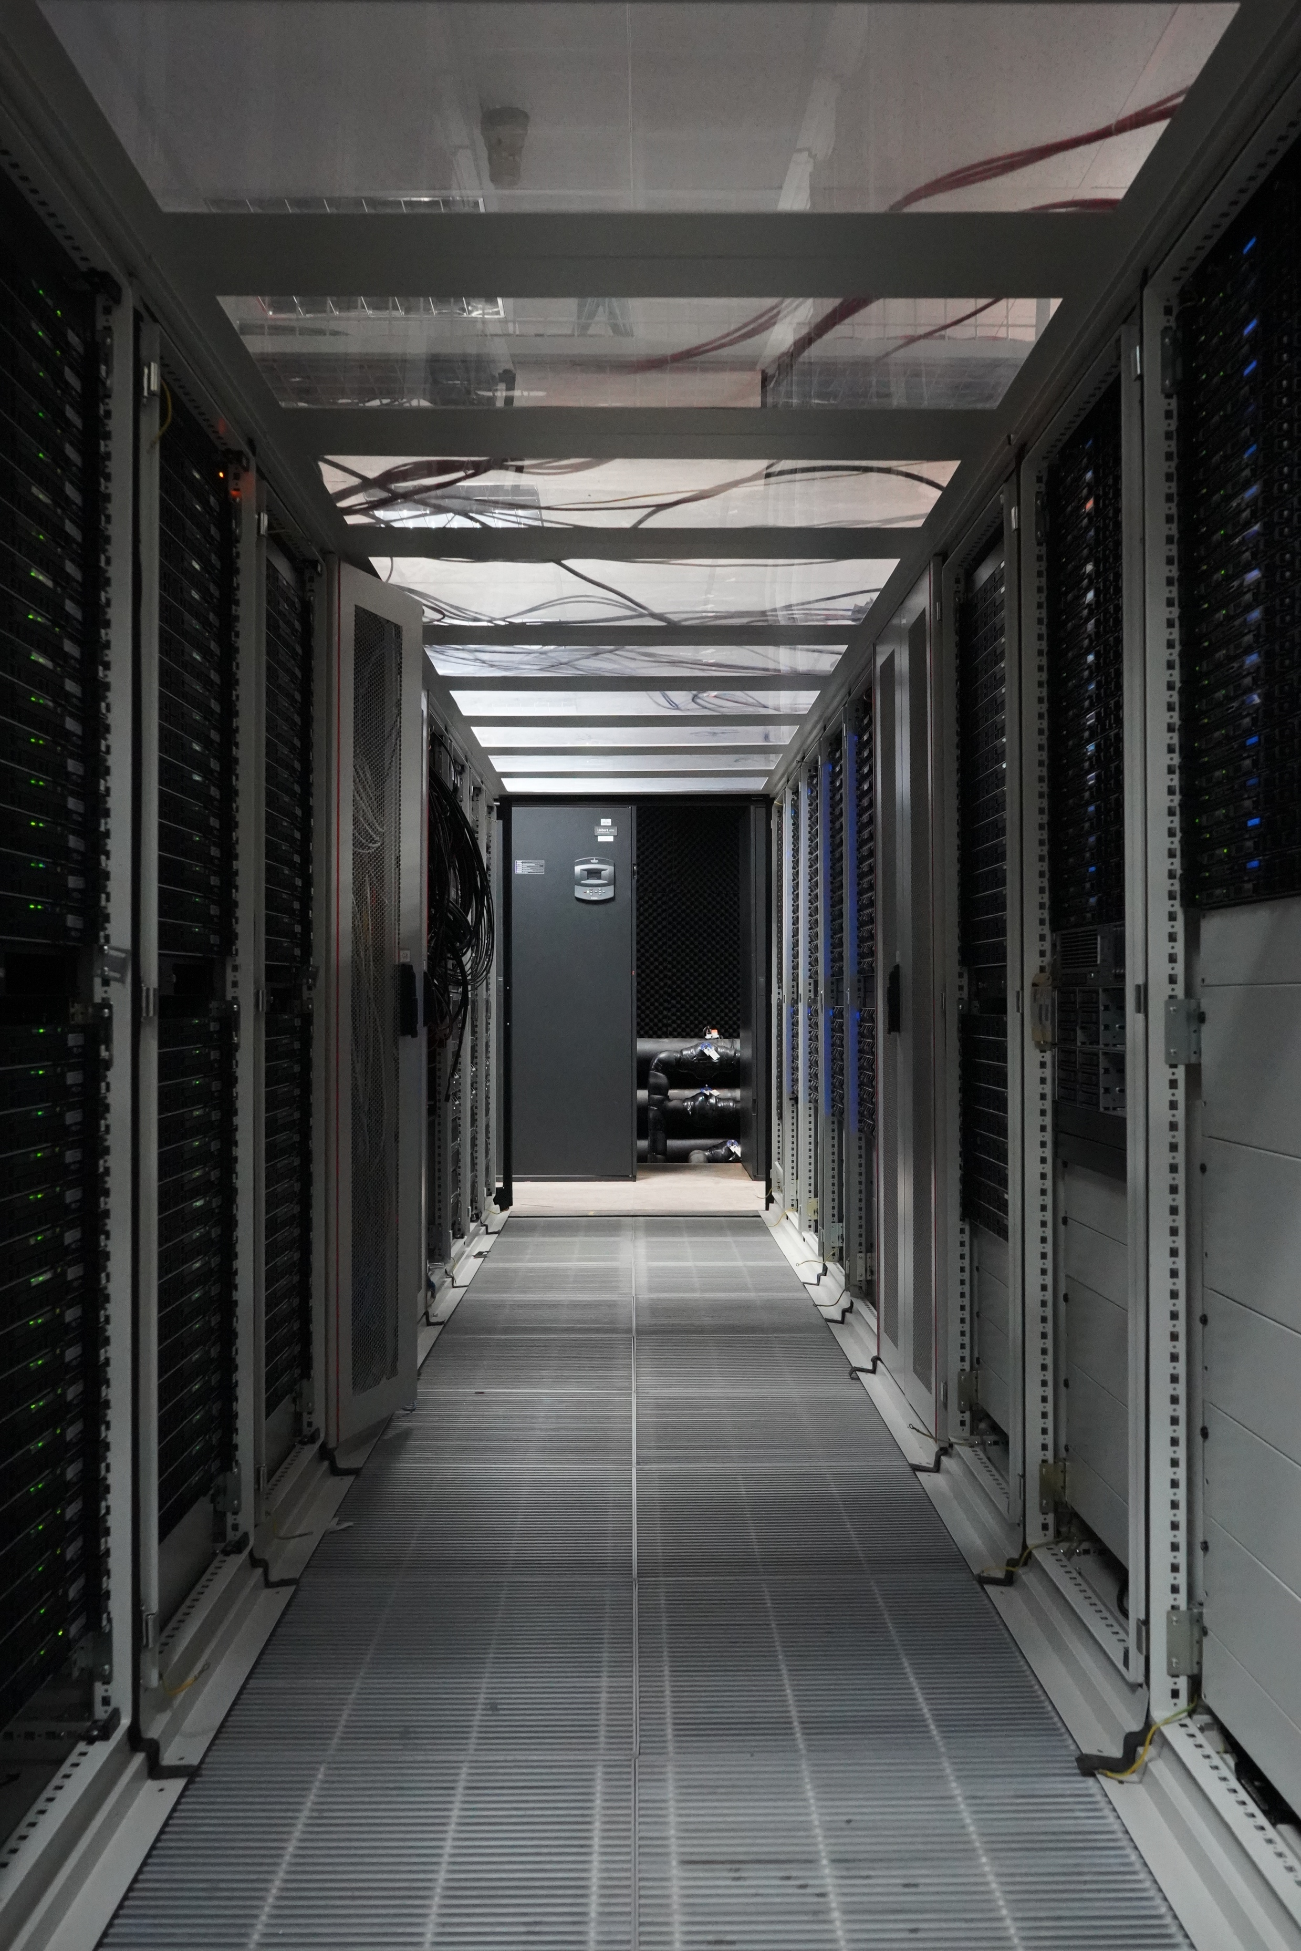

TRUBA – Memberships
EGI – Advanced Computing for Research
  Founding partner since 2010
  HTC, Federated Cloud
EuroHPC JU - EuroHPC Joint Undertaking
  Membership started in April 2019
  HPC, HPDA, AI
EOSC – European Open Science Cloud
  Membership started in 2020
  Research data

Slide 19

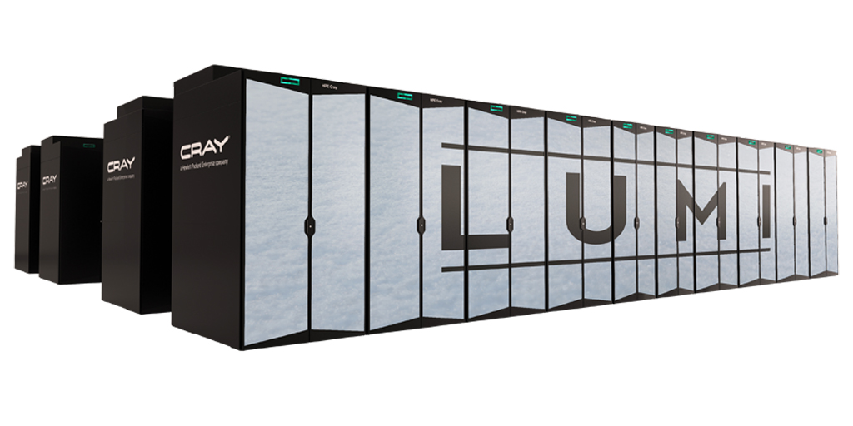
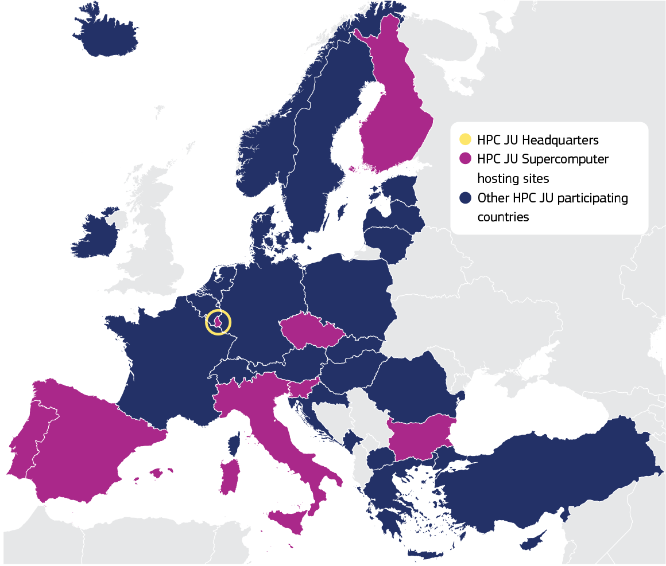





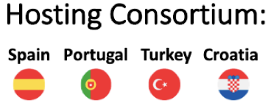
EuroHPC Joint Undertaking
EuroHPC Supercomputer Ecosystem
3 x Pre-exascale: Spain, Finland, Italy
5 x Petascale in first phase 4 more to be deployed
MareNostrum 5
19

Slide 20
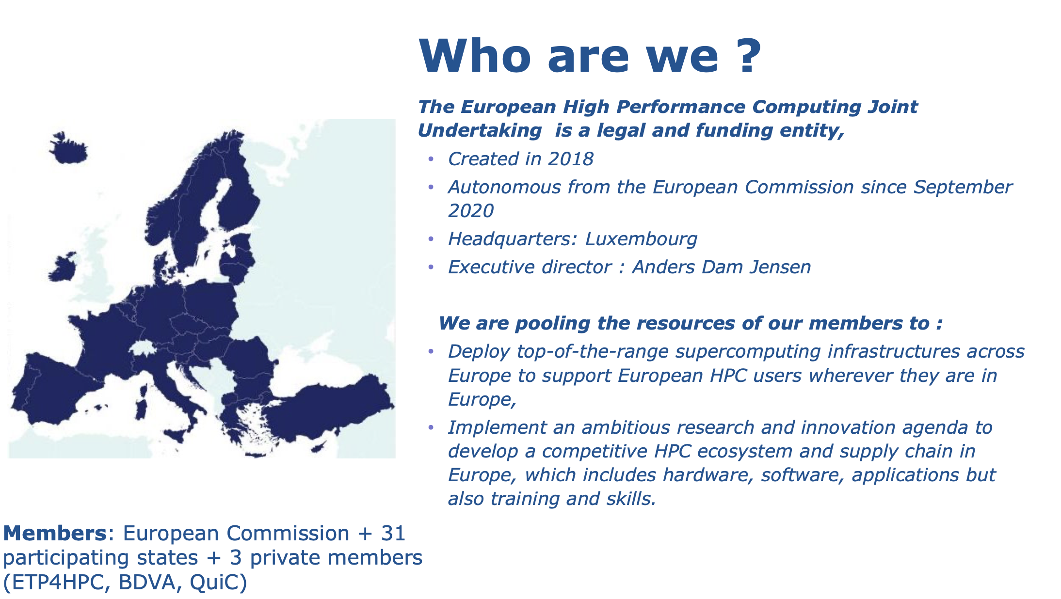

Slide 21
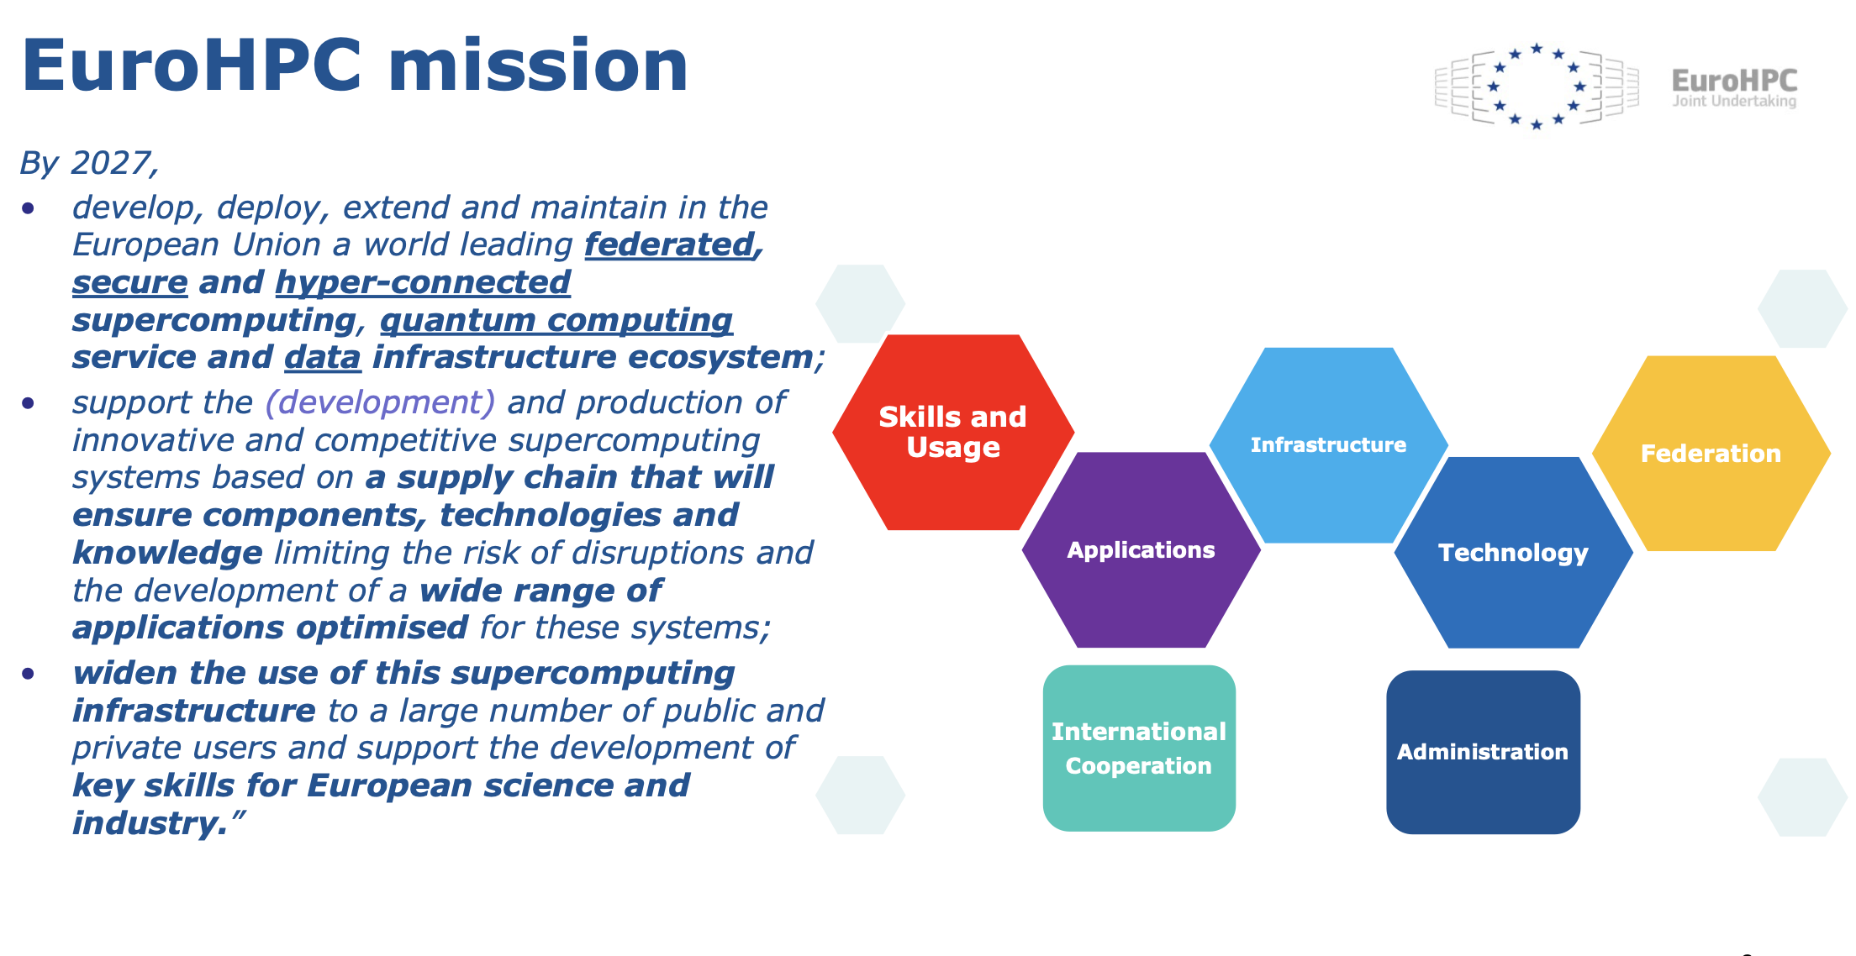

Slide 22
Turkey in EuroHPC R&I Calls
EuroHPC 2019 - Extreme scale computing and data driven Technologies call: SparCity Project (Koç and Sabancı Universities)
EuroHPC 2019 - HPC Competence Centres call: EuroCC (ULAKBİM, METU, İTÜ and Sabancı University)
MEEP (MareNostrum Experimental Exascale Platform) (TÜBİTAK TÜTEL)
The European Pilot (TÜBİTAK TÜTEL)
EuMaster4HPc (METU)
FF4EuroHPC EPOGRAHPC (Alti Dynamics, Nanografi, METU, ULAKBİM)

Slide 23
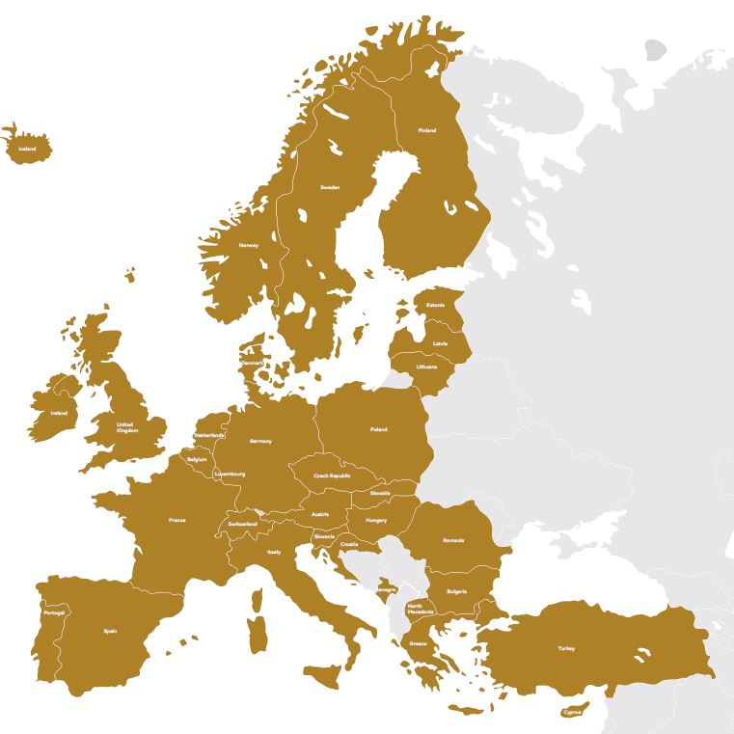
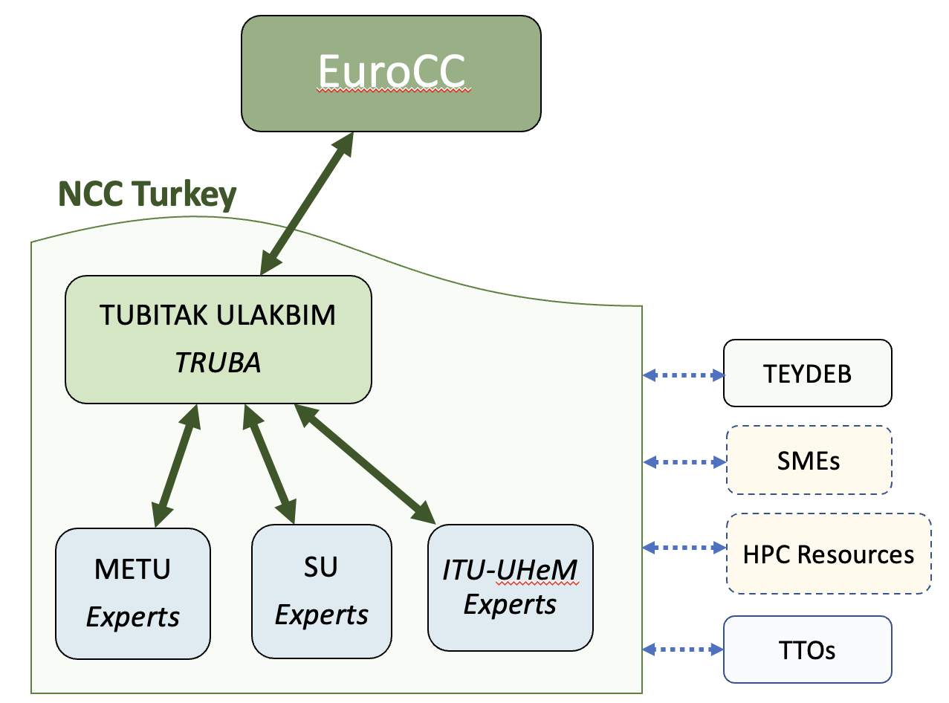
EuroCC@Türkiye National Competence Center
Lead Beneficiary - TÜBİTAK ULAKBİM
  TRUBA: National HPC Center
Third Parties
  Middle East Technical University
  Sabancı University
  Istanbul Technical University
    UHeM: National Center for HPC

Slide 24
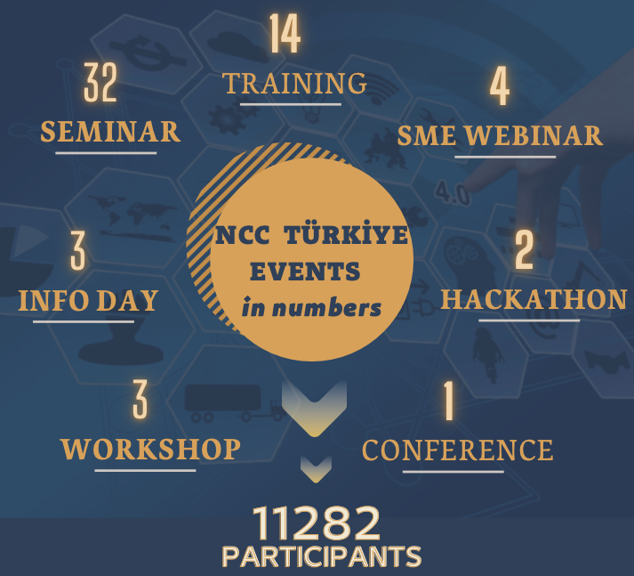
NCC TURKIYE EVENTS
NCC Türkiye has organised training activities in a variety of fields.
CFD using OPENFOAM
Big Data
Parallel Computing on GPUS with CUDA
Blockchain
AI in Medical Image Understanding
Electronic Structure Calculations with Atomic Simulation
Environment
Fundamentals of Deep Learning (In collaboration with
NVIDIA)
AI for Anomaly Detection (In collaboration with NVIDIA)
Graph School
Materials Modelling

Slide 25
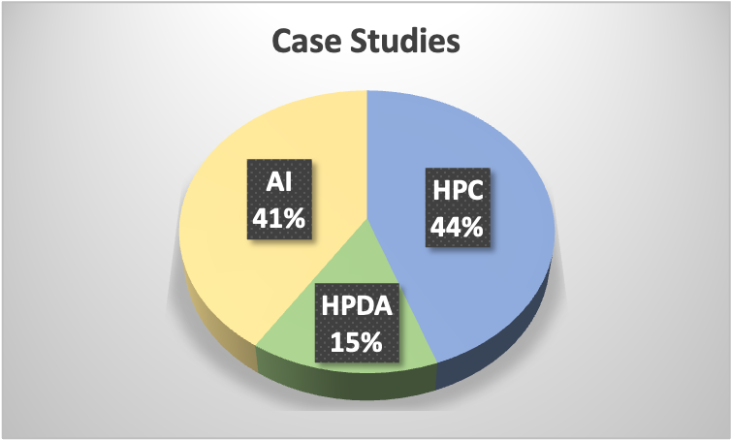





















Case Studies
Initializing 28 case studies in the field of HPC, AI, HPDA.
HPC & HPDA & AI
CFD
Material Sciences
Weather simulation
Antenna simulation
Particle simulation
  20 SMEs, 8 large companies
  Successfully completed: 10
  Success stories: 5

Slide 26
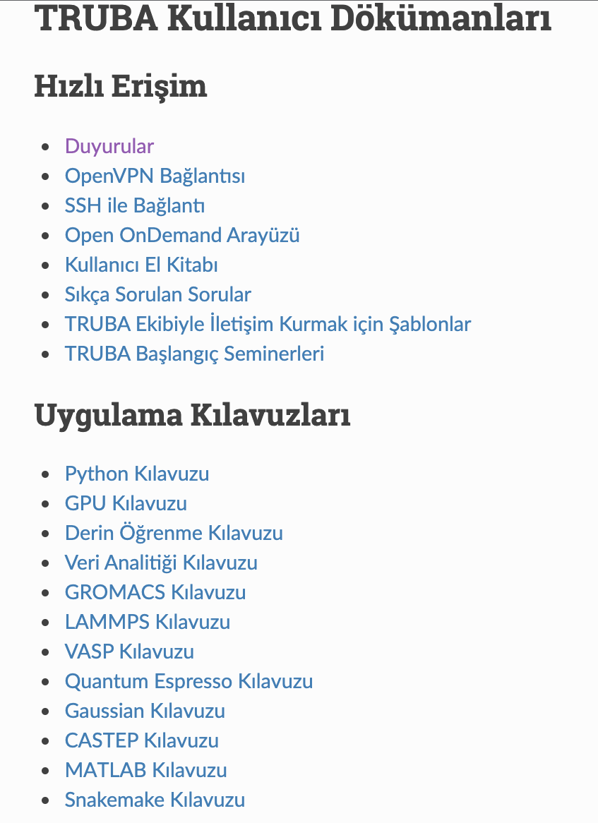
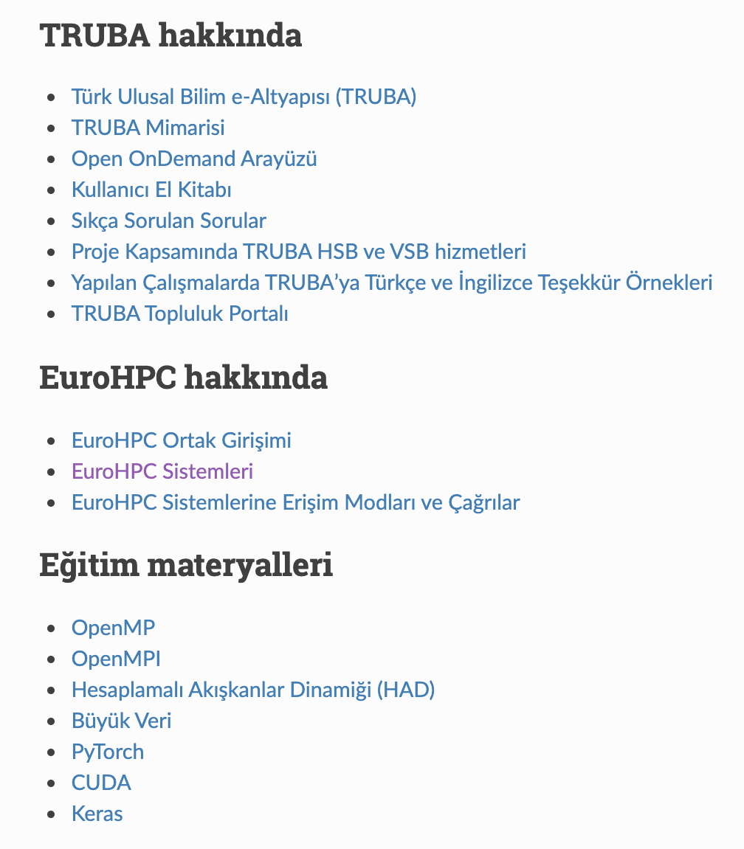
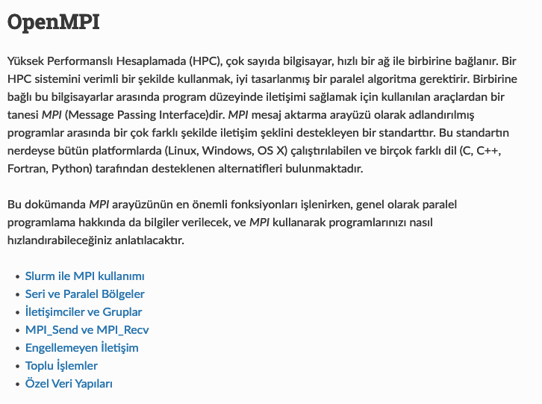
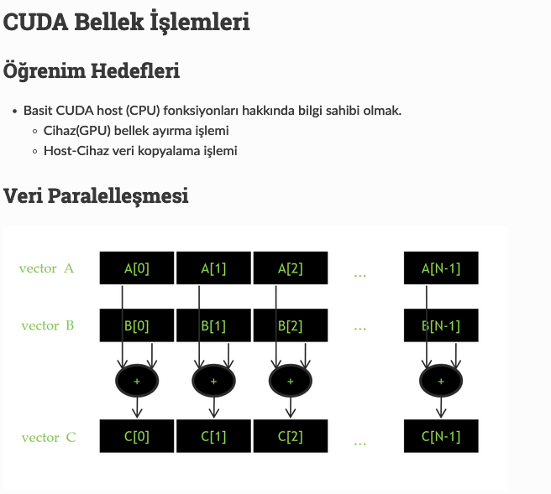
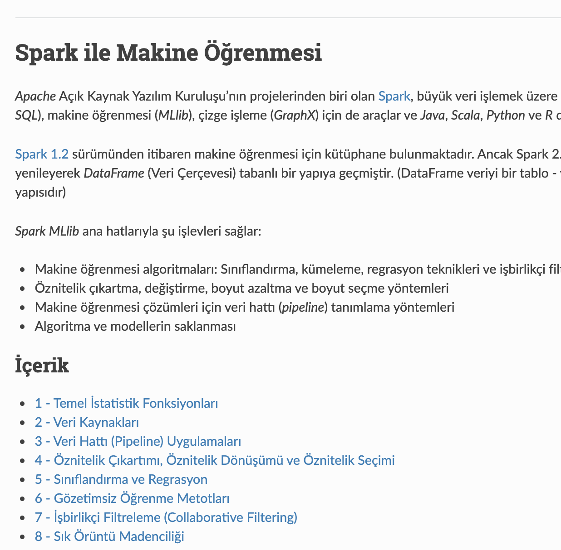


EuroCC@Türkiye – Technical Documentation Repository
https://docs.truba.gov.tr/

Slide 27
İletişim için;
grid@ulakbim.gov.tr
grid-teknik@ulakbim.gov.tr
http://www.truba.gov.tr
http://wiki.truba.gov.tr
http://docs.truba.gov.tr
http://portal.truba.gov.tr

